Slide 1
An Overview on WHIAANHPI
Washington State AAPI Small Business Summit
Bellevue, Washington
June 11, 2022

Slide 2
What is WHIAANHPI?
White House Initiative on Asian Americans, Native Hawaiians, and Pacific Islanders
  First established in 1999 under President Clinton
  Continued in different iterations across administrations for over two decades
  Reestablished by President Biden on May 28, 2021 by Executive Order (EO) 14031, “Advancing Equity, Justice, and Opportunity for Asian Americans, Native Hawaiians, and Pacific Islanders”

Slide 3
Mission of WHIAANHPI
The mission of the new WHIAANHPI is to drive an ambitious, whole-of-government agenda to advance equity, justice, and opportunity for AA and NHPI communities in 14 key priority areas:
  Identify and eliminate any existing institutional policies or barriers within Federal programs and services
  Improve safety, access to justice, and violence prevention
  Promote inclusion and belonging for AA and NHPI communities
  Expand the collection and use of disaggregated data at the Federal, State and local level
  End language access and other barriers
Notes:
AA and NHPI communities have grown exponentially and will more than double by 2060. This growth presents tremendous opportunity for engagement, and the Initiative will work hand-in-hand with you to ensure AA and NHPI communities have access to the federal government
In AA and NHPI communities, where one in three AA and NHPIs is limited English proficient, language access services can make the difference between life and death.

Slide 4
Mission of WHIAANHPI
  Improve health outcomes, eliminate health disparities, and expand access to quality, affordable, and culturally competent medical and mental healthcare services
  End disparities in educational outcomes for AA and NHPI youth and students of all ages, and address barriers to learning
  Address the concentration of poverty facing many AA and NHPI communities and access
  Expand economic opportunity for AA and NHPI families, including by advancing opportunities for AA and NHPI entrepreneurs and small businesses, supporting access to jobs and workforce training

Slide 5
Mission of WHIAANHPI
  Increase opportunities for civic engagement
  Improve the equitable allocation of Federal resources
  Support AA and NHPI communities in responding to and recovering from national or regional crises and public health emergencies
  Secure climate and environmental justice for AA and NHPI communities
  Identify ways to foster the recruitment, career and leadership development, retention, advancement, and participation of AA and NHPI public servants
Notes:
In the last two years, we’ve seen our communities hit hard by the COVID-19 pandemic and anti-Asian racism and violence.
That is why the Initiative has worked with the U.S. Department of Justice to ensure that hate crimes can be reported in several Asian languages, including Chinese (traditional and simplified), Korean, Vietnamese, Japanese, Tagalog, Punjabi, and Hindi. And it’s why we have worked with the U.S. Department of Health and Human Services to ensure that lifesaving COVID-19 information is translated into AA and NHPI languages.
We also pledge to protect limited English proficient individuals during disasters and through post-disaster recovery.
And beyond disasters, we’ll support these individuals by improving how the federal government administers language services

Slide 6
Interagency Working Groups
Senior-level Executive Branch officials designated by their respective agencies to coordinate WHIAANHPI’s work across the federal government
  Charged with creating and implementing strategic agency plans to help increase access to federal resources
  Works to advance equity, justice, and opportunity for AA and NHPI communities

Slide 7
Regional Network
Comprised of over 400 federal officials based in the 10 federal regions nationwide
First created under the Obama Administration in 2013
Tasked with coordinating outreach efforts and serving as a resource to connect AA and NHPI community stakeholders with federal resources
Notes:
The Regional Network institutionalizes a powerful community engagement mechanism that facilitates information sharing and coordinates on-the-ground engagement across the federal government’s regional offices that are based in ten federal regions across the nation.
Our long-term vision is to establish the Regional Network structure as a permanent part of the federal regional offices in order to continuously advance equity, justice, and opportunity for AA and NHPIs.

Slide 8
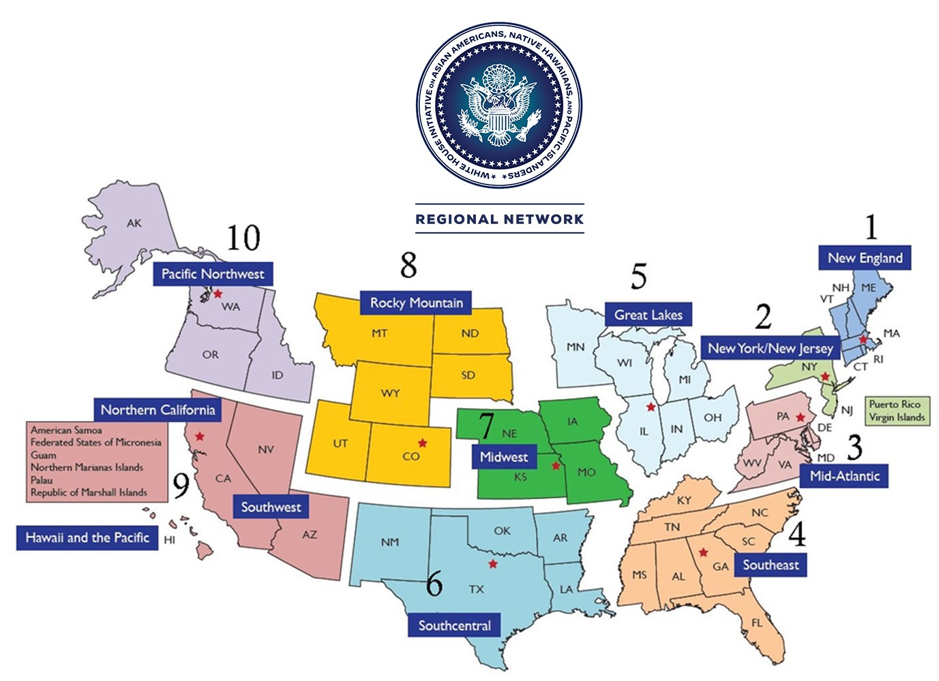
Regional Network
Notes:
The Regional Network spans far and wide — reaching AA and NHPI communities throughout the fifty states, District of Columbia, and Pacific Region.
The Regional Network, which perfectly complements WHIAANHPI’s federal Interagency Working Group, include individuals at all levels and from all backgrounds— including regional administrators, district directors, field directors, and staff.

Slide 9
Regional Network
  Coordinates community roundtables, events, and technical assistance
  Shares best practices and challenges
  Builds relationships
  Collaborates with state and local AA and NHPI commissions and elected officials;
  Shares information about federal resources, programs, and employment opportunities;
Notes:
Takes the Federal government to the AA and NHPI communities

Slide 10
Regional Network
  Solicits community feedback and recommendations
  Assesses the capacity building needs
  Explores opportunities for engagement with philanthropic organizations;
  Implements the recommendations of the White House Initiative and President’s Advisory Commission on AA and NHPIs
  Provides recommendations and guidance to WHIAANHPI
Notes:
Regional Network members also partner with each other to convene smaller regional roundtables. The purpose of these roundtables is to:
Provide education and technical assistance about the various federal programs and services that its regional offices offer; and
Hear from the AA and NHPI community about their particular concerns, issues, and recommendations.
These roundtables are at the heart of the Regional Network.

Slide 11
Regional Network
Contact Information
Stephen Yim, Co-Chair
U.S. Department of Labor
Yim.Stephen@dol.gov
Davis Zhen, Co-Chair
U.S. Environmental Protection Agency
Zhen.Davis@epa.gov

