Slide 1

Getting Back on Track Through Exporting

Slide 2


Slide 3
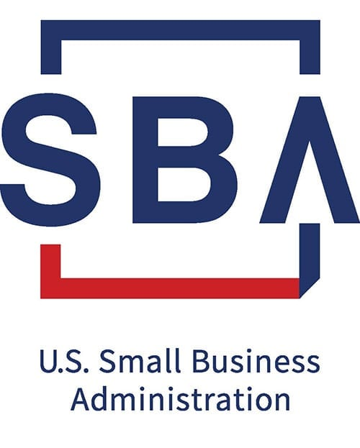
STEPS to Exporting Success
Company Export Readiness Assessment
Exporting Training / Obtain Advisory Assistance
Market Research / Identify Best Markets
Determining Exporting Methods and Channels
Developing an Export Strategy / Export Plan
Finding Qualified Buyers / Partners
Company Vetting
Business Travel Abroad
Developing a Marketing Strategy
Preparing and Financing Your Export Business
Pricing Questions, Quotations, and Terms
Methods of Payment / Financing Transactions
Shipping Your Product
After-Sales Services
Export 101 Education
Start With A Plan
Develop an Export Strategy and Export Plan
Meet Your Match
Services for experienced exporters of products,
services and technologies
Finance your Transaction
Finance and Risk Mitigation Services for new and experienced exporters of goods and services
Notes:
SBA Qualifications for Small Business Exporters are similar to SBA’s 7(a) and 504 Loan programs.
SBA can provide Export Loans to:
Existing Businesses who has been in operation (even if not exporting) for at least 12 months?
– OR –
Early-Stage Businesses with key personnel who have demonstrated export expertise and past business success?
– AND –
Early-Stage Businesses has an export business plan with a 12-month export sales projection and supporting narrative rationale

Slide 4






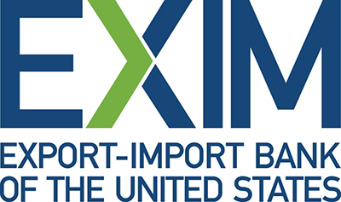

Notes:
It is now time for Questions and Answers

Slide 5
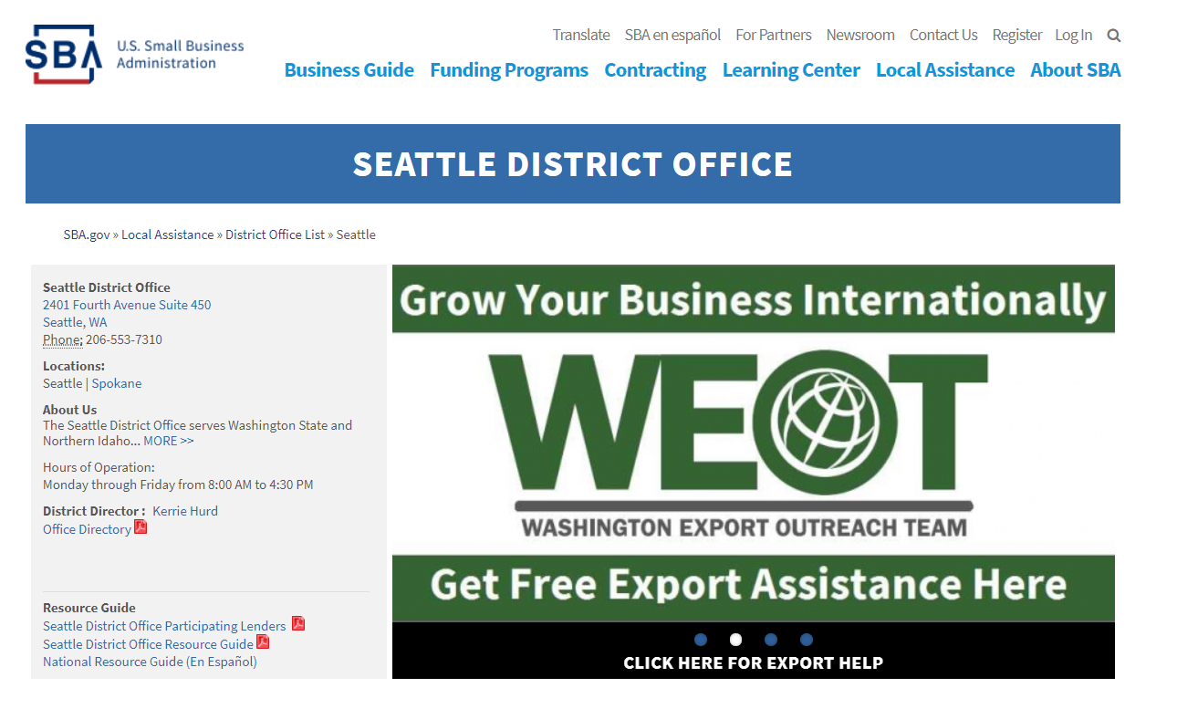
Connect with WEOT at www.sba.gov/wa
https://www.sba.gov/local-assistance/export-trade-assistance/washington-export-outreach-team
Notes:
You can find more information about the Washington Export Outreach Team on

Slide 6
Name | Agency | Email | Support and Expertise | Businesses Types Supported (Yes / No)
Brislin, John | SBA Office of International Trade – Seattle | John.Brislin@sba.gov | SBA Export Loan Programs. Training on International Payment Methods, International Trade Finance & Risk Mitigation. Lender Referrals. | New-to-Business (NTB) – Yes * New-to-Export (NTE) – Yes New-to-Market (NTM) – Yes Increase-to-Market (ITM) – Yes * Loans on Case-by-Case Basis
Burns, Luke | Western U.S. Agricultural Trade Association (WUSATA) | Luke@wusata.org | Matching Grants for International Marketing, Trade Missions, Trade Show Support, and Buyer Introductions | New-to-Business (NTB) – No New-to-Export (NTE) – Yes New-to-Market (NTM) – Yes Increase-to-Market (ITM) – Yes
Castillo, Zara | Export Finance Assistance Center of Washington | Zara.Castillo@efacw.org | Referrals, Financial Assistance, Export Training | New-to-Business (NTB) – Yes New-to-Export (NTE) – Yes New-to-Market (NTM) – Yes Increase-to-Market (ITM) – Yes
Dorsett, Maria | USDA – Foreign Agricultural Service – Credit Programs Division – Global Programs | Maria.Dorsett@fas.usda.gov | Trade Finance Programs for U.S. Agricultural Exports (known as GSM-102) and for Ag-Related Infrastructure Projects in Overseas Markets (known as Facility Guarantee Program). | New-to-Business (NTB) – No New-to-Export (NTE) – Yes New-to-Market (NTM) – Yes Increase-to-Market (ITM) – Yes
Gunkle, Nicole | Washington State Department of Commerce – Export Assistance Team | Nicole.Gunkle@commerce.wa.gov | Advocacy, Consulting, Market Research, Trade Missions and Trade Show Support, Business Matchmaking, STEP Grants | New-to-Business (NTB) – No New-to-Export (NTE) – Yes New-to-Market (NTM) – Yes Increase-to-Market (ITM) – Yes
He, Ellie | Washington Small Business Development Center – Western Washington | Ellie.He@wsbdc.org | Export Planning and Technical Business Advising, Free International Market Research | New-to-Business (NTB) – Yes * New-to-Export (NTE) – Yes New-to-Market (NTM) – Yes Increase-to-Market (ITM) – Yes * NTB: Please use Business Question Contact Form at https://wsbdc.org/contact-us/
Holloway Jarman, Kellie | U.S. Commercial Service – Portland (Vancouver & SW Washington) | Kellie.Holloway@trade.gov | Foreign Company Vetting, Distributor Searches, Trade Shows, Missions, Embassy Staff | New-to-Business (NTB) – No New-to-Export (NTE) – Yes New-to-Market (NTM) – Yes Increase-to-Market (ITM) – Yes

Slide 7
Name | Agency | Email | Support and Expertise | Businesses Types Supported (Yes / No)
Johnson, Julie | Washington State Department of Agriculture | JJohnson@agr.wa.gov | Exporting Agricultural Products, Referrals, Company Recruitment & Outreach, Market Access | New-to-Business (NTB) – Yes New-to-Export (NTE) – Yes New-to-Market (NTM) – Yes Increase-to-Market (ITM) – Yes
Martinez, Abby | Export-Import Bank of the United States (EXIM Bank) – Seattle | Abby.Martinez@exim.gov | Export Credit Insurance, Export Loan Programs | New-to-Business (NTB) – New-to-Export (NTE) – Yes New-to-Market (NTM) – Yes Increase-to-Market (ITM) – Yes
Mooney, Diane | U.S. Commercial Service – Seattle | Diane.Mooney@trade.gov | Foreign Company Vetting, Distributor Searches, Trade Shows, Missions, Embassy Staff | New-to-Business (NTB) – No New-to-Export (NTE) – Yes New-to-Market (NTM) – Yes Increase-to-Market (ITM) – Yes
Newton, Jim | SBA Office of International Trade – Portland (Vancouver & SW Washington) | James.Newton@sba.gov | International Trade Financing, SBA Lending | New-to-Business (NTB) – Yes * New-to-Export (NTE) – Yes New-to-Market (NTM) – Yes Increase-to-Market (ITM) – Yes * Loans on Case-by-Case Basis
Peterson, Allan | Washington Small Business Development Center – Eastern Washington | Allan.Peterson@wsbdc.org | Export Planning and Technical Business Advising, Free International Market Research | New-to-Business (NTB) – Yes * New-to-Export (NTE) – Yes New-to-Market (NTM) – Yes Increase-to-Market (ITM) – Yes * NTB: Please use Business Question Contact Form at https://wsbdc.org/contact-us/
White, Lisa | U.S. Commercial Service – Seattle | Lisa.White@trade.gov | Foreign Company Vetting, Distributor Searches, Trade Shows, Missions, Embassy Staff | New-to-Business (NTB) – No New-to-Export (NTE) – Yes New-to-Market (NTM) – Yes Increase-to-Market (ITM) – Yes

Slide 8
U.S. Small Business Administration – SBA Office of International Trade
Presented by: John Brislin
Counseling
Loans
Grants
Referrals
Training
Notes:
SBA’s Office of International Trade was created in 1980 (PL 96-481)
SBA Office of International Trade was expanded by Small Business Jobs Act of 2010 (PL 111-240 ) to include the State Trade Expansion Program (STEP)
SBA’s Office of International Trade has thirty-nine positions. Gabe Esparza (Associate Administrator, Michelle Schimpp (Deputy Associate Administrator) and Staff Assistant, and four functions:
Trade Finance – Team of 26 I Export Finance Experts: 23 spread across the U.S. with the majority located in U.S. Export Assistance Centers and 2 in SBA HQ – Dan Pische (National Trade Finance Director)
STEP – Team of 5 located in Washington, DC. – Shadetra Robinson (Director of the State Trade Expansion Program)
Trade Policy – Team of 2 located in Washington, DC – Christine Brown (Director of Trade Policy)
Operations – Team of 3 located in Washington, DC – Jim Parker (Director of Operations)

Slide 9
Are You:
For-profit business and meet SBA size standards?
Direct Exporter or Indirect Exporter?
Do your products and/or services ship from the United States?
Do you demonstrate good character, credit, management, and ability to repay?
Existing business who has been in operation (even if not exporting) for at least 12 months? – OR –
Early-stage business with key personnel who have demonstrated export expertise and past business success? – AND –
Do you have an export business plan with a 12-month export sales projection and supporting narrative rationale?
Are you looking for:
Grants for export market development and eCommerce
Loans to support your exporting activities
Notes:
SBA Qualifications for Small Business Exporters are similar to SBA’s 7(a) and 504 Loan programs.
SBA can provide Export Loans to:
Existing Businesses who has been in operation (even if not exporting) for at least 12 months?
– OR –
Early-Stage Businesses with key personnel who have demonstrated export expertise and past business success?
– AND –
Early-Stage Businesses has an export business plan with a 12-month export sales projection and supporting narrative rationale

Slide 10
SBA Office of International Trade - What Do We Do?
Goal According to Statute
Increase the Number of Small Business Exporters
Increase the Volume of Small Business Exports
Grants to Find International Buyers
Exporting Advice & Advocacy
U.S. Small Businesses
Financing for International Sales
Notes:
95% of the world’s consumers live outside the U.S. yet only a small percentage of our 30 million U.S. small businesses are actively focused on global market growth.
Perhaps not enough small business owners know that exporters are more financially stable, expand faster, and create higher paying jobs than non exporters. Exporters are also more resilient as they reduce their dependency on a single market.
We are constantly asking ourselves, why don’t more small businesses export?:
There are Three Main Reasons that we consistently see are:
They don’t know where to start,
They believe that the regulatory environment is too complex or
They find it difficult to finance global sales
Fortunately, SBA has solutions to each of these obstacles with Business Intelligence for Changing Times, Grants to Reach International Buyers. and Financing for Your International & Supply Chain Sales .
We want every business to know that SBA has solutions to obstacles they face in selling to international customers:
Advice and counseling for businesses that don’t know where to start or are worried about complex regulations.
Grants to cover costs associated with finding international buyers or entering new foreign markets.
Loans tailored to provide export working capital, business expansion or other costs associated with international operations.

Slide 11
SBA Office of International Trade Support
SBA Export Loan & Export Grant Programs
Export Market Development
eCommerce Development
Export Working Capital: Pre-Shipment - AND - Post-Shipment
Standby Letters of Credit: Bid Bonds, Performance Bonds and Advance Payment Guarantees
Fixed Assets Financing: Real Estate, Machinery and Equipment
Permanent Working Capital
Debt Refinancing
Business Acquisition / Change of Ownership
Export Express
Export Working Capital Program
International Trade Loan
STEP Grant
Notes:
KEY TAKEAWAY MESSAGE: Get Financing for International Sales with SBA Loan Guarantees
SBA partners with lenders to offer three different export loan products – these loan products address a range of business financing needs Not only for direct - but also for indirect exporters – Those businesses who sell to other US businesses that then export their products. – Think supply chain.
SBA’s three export loan programs are helping businesses achieve roughly $2.3 billion in sales per year.
The SBA’s Export Express Loan program allows access to capital quickly for businesses that need financing up to $500,000. You can apply for a line of credit prior to finalizing an export sale or even before visiting a foreign market. Getting your financing lined up ensures that adequate financing is in place before you agree to contract terms.
Small Business Exporters can use the Export Working Capital Program to fulfill export orders and finance international sales by providing revolving lines of credit of up to $5 million.
The International Trade Loan program can help if your company has been affected by foreign competition and needs to retool or expand to better compete. It can also help exporting firms seeking to expand international sales.

Slide 12
Export Express
Capital for Export Development
Export Market Development
eCommerce Development
Short-Term Working Capital: General Purpose Line of Credit
Standby Letters of Credit: Bid Bonds, Performance Bonds and Advance Payment Guarantees
Fixed Assets Financing: Real Estate, Machinery and Equipment
Permanent Working Capital
Debt Refinancing
Business Acquisition / Change of Ownership
Export Express
Export Working Capital Program
International Trade Loan
STEP Grant
Notes:
Companies need to adapt to sell into a Phygital Business Environment where business is conducted physically in-person and virtually using digital platforms (websites & eCommerce).
Supply Chain: Manufacturing and wholesale trade and service sector businesses have embraced e-commerce because it streamlines the process of purchasing and selling components and products to other businesses.
Costs for Export Market Development and eCommerce Development can go well above the funding provided by the State Trade Expansion Program (STEP) Grant Program.
SBA Loans of $350 Thousand or Less for FY2022 – Ending September 30, 2022
SBA Guarantee Fee – Paid by Business – is waived – Zero
SBA Ongoing Servicing Fee – Paid by Lender – is waived – Zero
SBA Export Express Loans of $350 Thousand or Less have a 90% Guarantee to Lender
SBA Export Express Loans over $350 Thousand and Up to $500 Thousand and have a 75% Guarantee to Lender
SBA Express offers 50% Guarantee for loans up to $500 Thousand

Slide 13
Export Working Capital Program (EWCP)
Working capital to fulfill export orders
Pre-Shipment Financing against Contracts and Purchase Orders that provides short-term working capital to secure raw materials, components and services from Suppliers
Post-Shipment Financing that provides short-term working capital to support longer Cash Conversion Cycles with Foreign Buyers
Standby Letters of Credit: Bid Bonds, Performance Bonds and Advance Payment Guarantees
Export Express
Export Working Capital Program
International Trade Loan
STEP Grant
Notes:
Businesses who can pay cash in advance to Suppliers are in a better position to secure raw materials and components and services required for production. An EWCP Loan can allow businesses to obtain working capital based upon Sales Contracts and Purchase Orders.
Higher Advance Rates: The Maximum Advance Rate is 90% of the Purchase Order / Sales Contract or the Borrower’s costs (including overhead), whichever is less
Businesses who sell to Foreign Buyers on open account (extended payments) have a competitive advantage over their competitors. These businesses can receive higher advance rates from their Lenders on Foreign Accounts Receivables. Transit times for shipments have increased due to Labor, Vessel, and Container Shortages.
Higher Advance Rates: Up to 75% against Export Inventory and Up to 90% against Export Accounts Receivable.
EWCP Loan Program provides a 90% Guarantee for Loans up to $5 Million to a Lender (Up to a $4.5 Million Maximum Guarantee Amount)
CAPLines Working Capital Loan Program provides an: 85% guaranty to a Lender for loans of $150 Thousand or less and 75% guaranty for loans greater than $150,000 (Up to $3.75 million maximum guaranty Amount)

Slide 14
International Trade Loan Program
Capital for Expanding Exporter Capacity
Funds for Fixed Assets Financing for Business Expansion
Permanent Working Capital
Debt Refinancing
Business Acquisition to Increase Production and Enhance Exporting Capabilities
Reshoring Production Back On-shore
Company adversely impacted by Foreign Competition
Export Express
Export Working Capital Program
International Trade Loan
STEP Grant
Notes:
Funds for Fixed Assets Financing Businesses Expansion needed for Business Expansion as Foreign Sales Increase
Reshoring as Part of a Business Plan to Grow Sales in Foreign Markets. Businesses can qualify even if anticipated export sales will be less than a majority of their sales or if they intend to sell only one product abroad. Businesses can also qualify if they only sell to foreign buyers indirectly – e.g., as part of a supply chain or an intermediate distributor – may also qualify.
– Or If –
Reshoring as Part of a Business Plan to Respond to Significant Foreign Competition That Has Cut Into Their U.S. Market Sales. Businesses that currently operate abroad but sell to the U.S. market can take advantage of an International Trade Loan too. These businesses must demonstrate an adverse impact on their business due to import competition.
Business Acquisition to Increase Production and Enhance Exporting Capabilities: Opportunities that arise from Businesses who acquiring Competitors and/or Suppliers that will increase production capabilities and strengthen their position in the long-term towards exporting
International Trade Loan offers a 90% guaranty to a Lender: (up to $4.5 Million Maximum Guaranty Amount) and (Up to $4 Million Maximum Guaranty Amount For Permanent Working Capital)
7(a) Loan Program provides an: 85% guaranty to a Lender for loans of $150 Thousand or less and 75% guaranty for loans greater than $150,000 (Up to $3.75 million maximum guaranty Amount)

Slide 15
State Trade Expansion Program (STEP) Grant Program
Grants to Reach International Buyers
The State Trade Expansion Program (STEP) Grant Program provides grants to U.S. States & Territories to help small businesses to go international
Eligible Uses of Funds include:
    Training workshops
    In-person and Virtual Trade Shows & Trade Missions
    Services to support Foreign Market Entry
    International Partner Search
    Website optimization for global sales
    Translate websites to attract foreign buyers
    Designing marketing media and more
Export Express
Export Working Capital Program
International Trade Loan
STEP Grant
Notes:
Funds for Fixed Assets Financing Businesses Expansion needed for Business Expansion as Foreign Sales Increase
Reshoring as Part of a Business Plan to Grow Sales in Foreign Markets. Businesses can qualify even if anticipated export sales will be less than a majority of their sales or if they intend to sell only one product abroad. Businesses can also qualify if they only sell to foreign buyers indirectly – e.g., as part of a supply chain or an intermediate distributor – may also qualify.
– Or If –
Reshoring as Part of a Business Plan to Respond to Significant Foreign Competition That Has Cut Into Their U.S. Market Sales. Businesses that currently operate abroad but sell to the U.S. market can take advantage of an International Trade Loan too. These businesses must demonstrate an adverse impact on their business due to import competition.
Business Acquisition to Increase Production and Enhance Exporting Capabilities: Opportunities that arise from Businesses who acquiring Competitors and/or Suppliers that will increase production capabilities and strengthen their position in the long-term towards exporting
International Trade Loan offers a 90% guaranty to a Lender: (up to $4.5 Million Maximum Guaranty Amount) and (Up to $4 Million Maximum Guaranty Amount For Permanent Working Capital)
7(a) Loan Program provides an: 85% guaranty to a Lender for loans of $150 Thousand or less and 75% guaranty for loans greater than $150,000 (Up to $3.75 million maximum guaranty Amount)

Slide 16
SBA Contact Information
John Brislin Jim Newton
Export Finance Manager Export Finance Manager
Washington, Northern Idaho & Alaska Oregon, SW Washington & Southern Idaho
SBA Office of International Trade SBA Office of International Trade
Seattle – U.S. Export Assistance Center Portland – U.S. Export Assistance Center
Email: john.brislin@sba.gov Email: james.newton@sba.gov
Tel: 206-584-3486 Tel: 503-367-6936
Janie Sacco
Outreach and Marketing Specialist
SBA Seattle District Office – Washington & Northern Idaho
Email: janie.sacco@sba.gov
Tel: 206-300-3863
Counseling
Loans
Grants
Referrals
Training
Notes:
SBA’s Region 10 covers the state of Washington, Oregon, Idaho, and Alaska
John Brislin and Jim Newton are the two SBA Office of International Trade – Export Finance Managers who work with Lenders to support Small Business Exporters.
John and Jim work with SBA District Offices Seattle (and Spokane Branch Office, Portland, Boise, and Anchorage within SBA Region 10.
SBA District Offices have Lender Relations Specialists & District International Trade Officers with Cathy Griffith in Seattle, Ashley Lambeth in Portland, Christian Pennington in Boise, and Nelida Irvine in Anchorage who work with John and Jim.
SBA Lender Relations Specialists work with Lenders with SBA’s 504 & 7(a) Loan Programs.
SBA District International Trade Officers serve as the liaison between SBA District Offices and SBA’s Office of International Trade

